Slide 1

Medical Office Merger
Shantel reid, ebonee smiley, willie solomon, nazir terrell
COMPUTER & INFORMATION SYSTEMS, ECPI UNIVERSITY
CIS207L: Routing and switching lab
DR. rufi, a.
JANUARY 10, 2024

Slide 2
The Project
The purpose of this project is to:
Connect the multiple offices into one with a singular dedicated working network
Fix security concerns within the network
Create a solution to the HIPPA and FERPA policy violations
Restructure the network to run smoother and with little to no issue

Slide 3
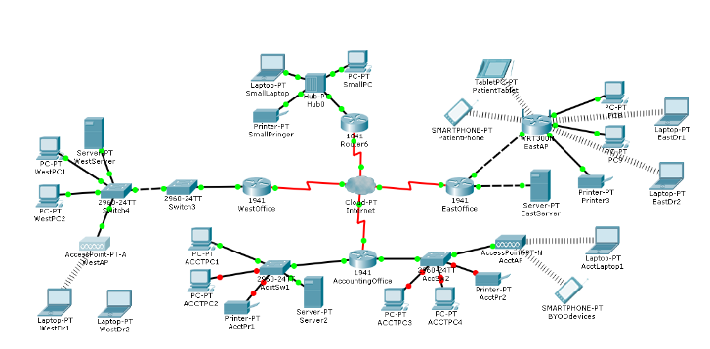
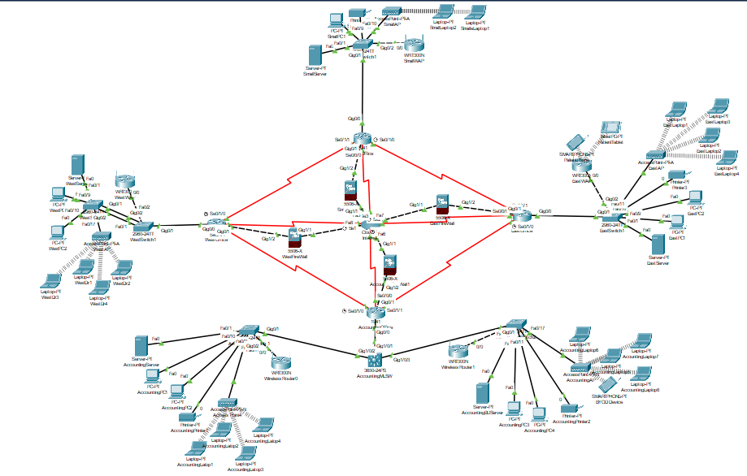
Previous Network
Updated Network

Slide 4
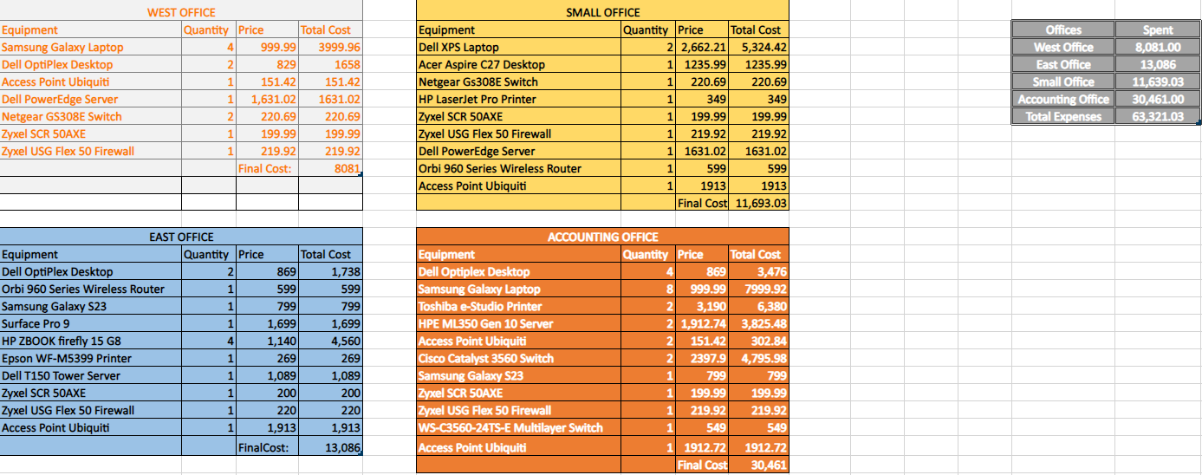

Slide 5
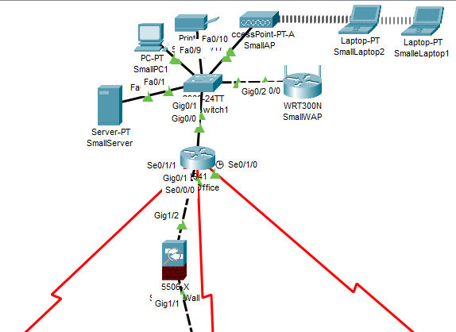
Changes (Small Office)
Added restrictions to what can and cannot be accessed by staff and patients
Added a server to the office
Added Access Point for staff to connect to internet with devices from home
Added Access Point for patients to connect to internet

Slide 6
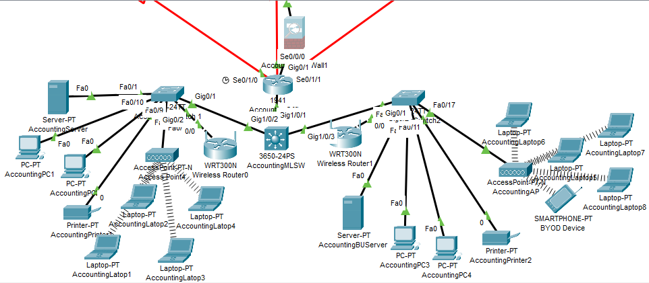
Changes (accounting Office)
Added restrictions to what can and cannot be accessed by staff and patients
Added a second server to the office for data security
Added second Access Point for staff to connect to internet with devices from home
Added Access Point for patients to connect to internet

Slide 7
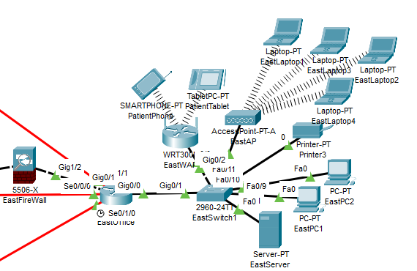
Changes (East Office)
Added restrictions to what can and cannot be accessed by staff and patients
Allow staff to access the internet using devices brought from home
Allow patients to access the internet in the office

Slide 8
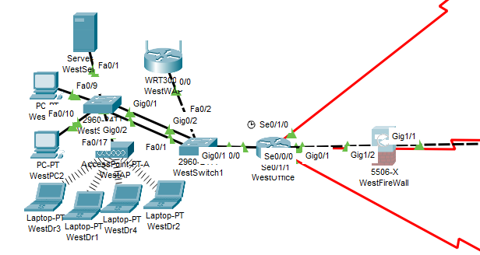
Changes (West Office)
Added restrictions to what can and cannot be accessed by staff and patients
Allow staff to access the internet using devices brought from home
Allow patients to access the internet in the office

Slide 9
Hippa & Ferpa
Patients and Staff have different access points to the network
This along with restrictions on what can and can't be accessed prevent patients from having access to any branches data and staff from having access to unrelated offices data

Slide 10
References
HIPAA SECURITY RULE REQUIREMENTS & HOW TO COMPLY - TOTEM. (N.D.). WWW.TOTEM.TECH. HTTPS://WWW.TOTEM.TECH/HIPAA-CYBERSECURITY-COMPLIANCE/
WHAT IS FERPA COMPLIANCE? - MEANING, LAWS & MORE | PROOFPOINT US. (2021, AUGUST 2). PROOFPOINT. HTTPS://WWW.PROOFPOINT.COM/US/THREAT-REFERENCE/FERPA-COMPLIANCE#:~:TEXT=IN%20ADDITION%20TO%20PROTECTING%20STUDENT

